Slide 1
Ames Housing Price Prediction Model
By: Alyse, Sim Yi

Slide 2
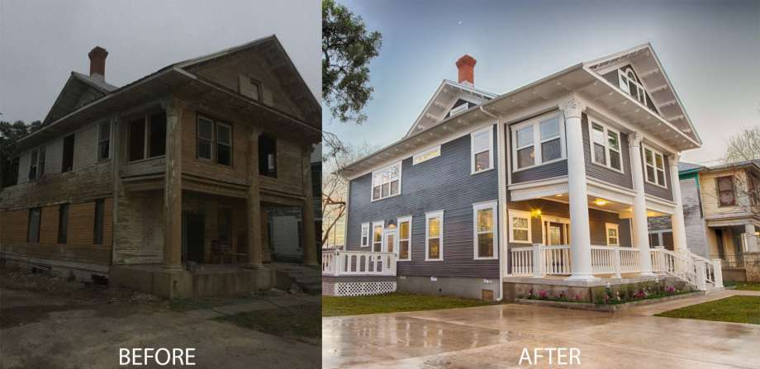
Background
Who are we?
HOUSE FLIPPING CONSULTANCY SERVICE With Core Business in Other Midwestern States
We are expanding in the Neighbouring state of Iowa with Ames as our first target

Slide 3
Background
Why Iowa? Why Ames?
Seller’s Market:
3.9% Increase in Y-o-Y House Prices (2018)
Overall Increase in Number of Houses Sold
Booming Home Sales in Ames:
9.4% Increase in Y-o-Y Number of Houses Sold
Highly Profitable:
Cheap renovation and remodelling costs
Average flip earns an average of US$ 54K
Top 50 cities in United States for profiting from house flips

Slide 4
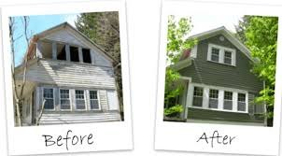
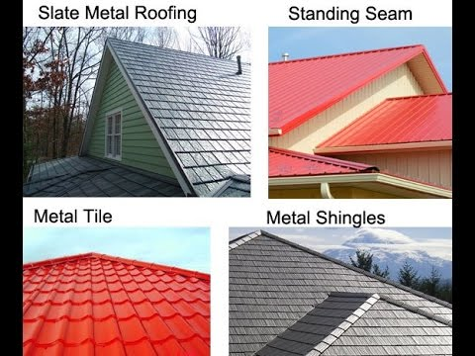

Problem Statement
What are we trying to address?
Identify key driving factors for maximising returns from house flipping activities
Fence
WHAT TO
BUY
HOW TO
RENOVATE
WHEN TO
SELL
Porch

Slide 5
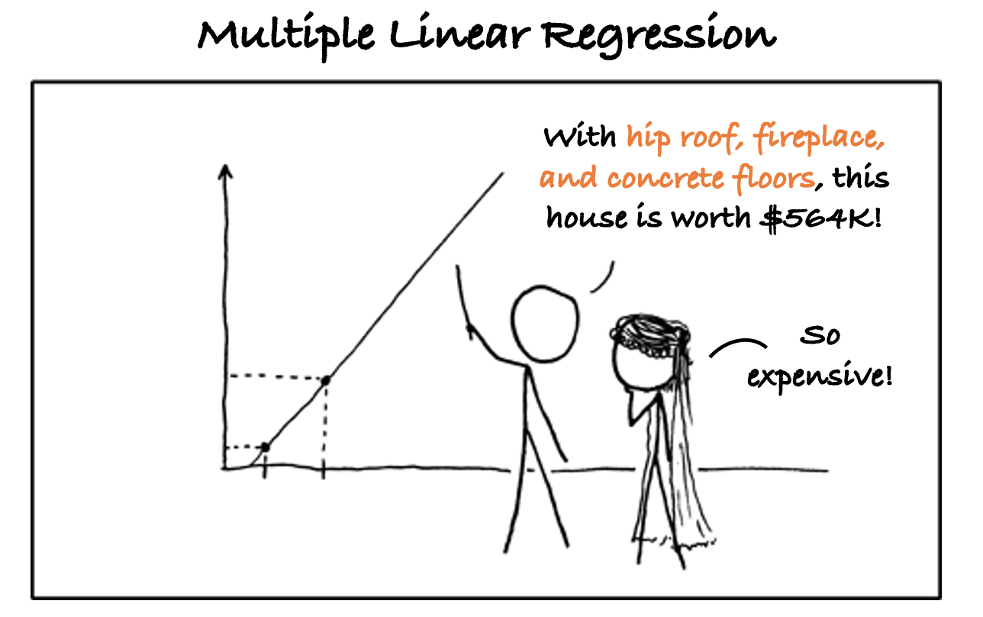
Problem Statement
How are we going to do it?

Slide 6
Project Overview
End-to-end management of project
Data Preparation
Data Cleaning
Exploratory Data Analysis
Exploratory Visualizations
Correlations with Dependent Variable
Multicollinearity
Skewness
Modeling and Testing
Inferential Visualizations
Conclusion & Recommendations

Slide 7
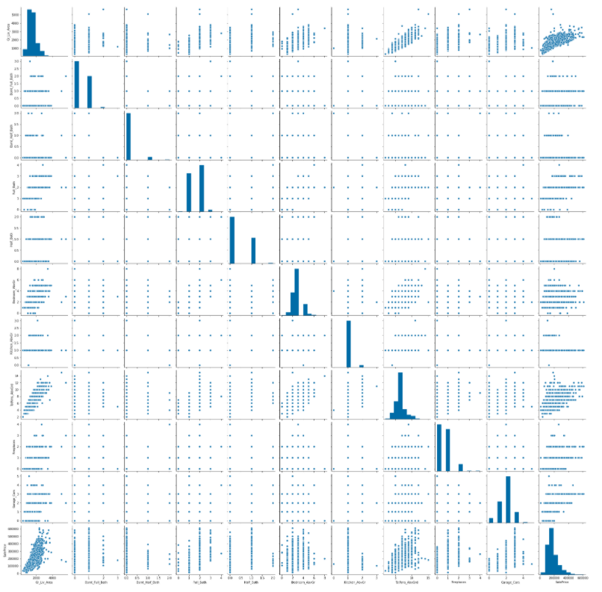
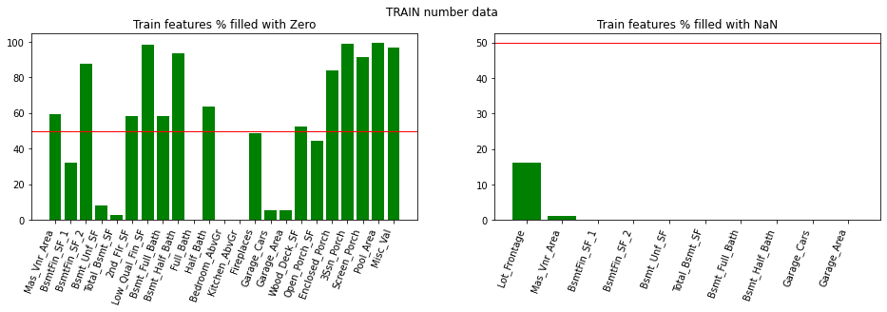
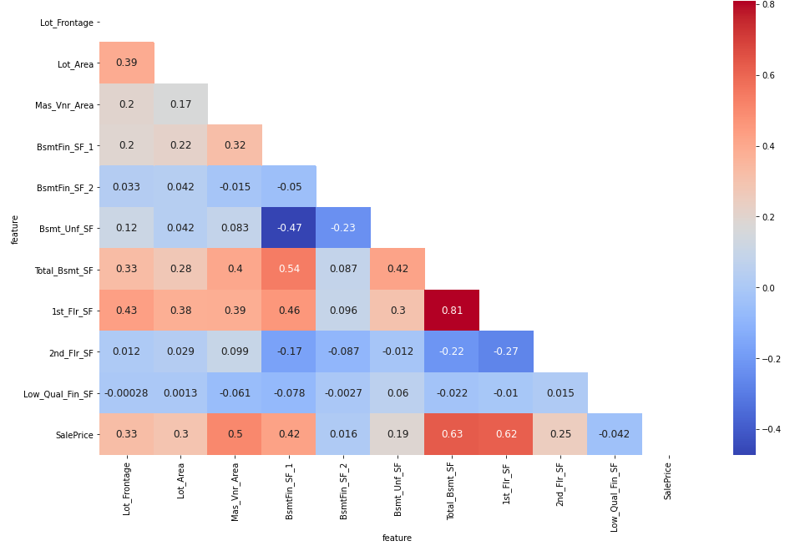
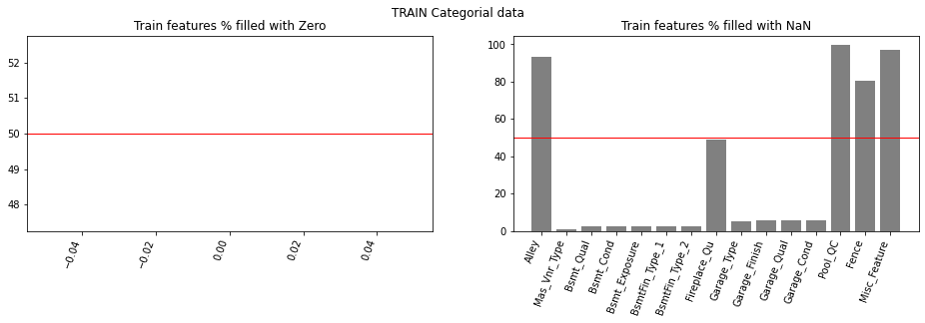
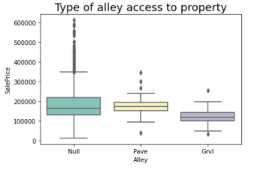
Data Processing
How we classified our data
Spread / Scatter
Numerical - Nominal and Ordinal
Correlation
Categorical - Nominal and Ordinal
Notes:
Numerical data types: Look at the spread with scatter plot and correlation to Target variable, SalePrice
Categorical data type: convert into numerical values for ordinal data set, plot with box plot to look at the spread of the data.

Slide 8
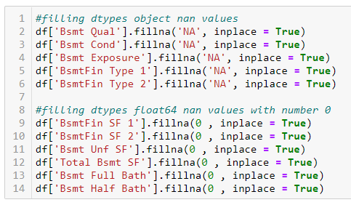
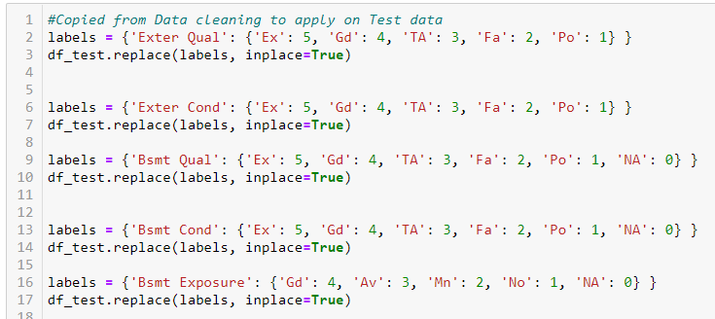
Data Cleaning
How did we prepare our data for modelling?
Filling null values with :
0 for numerical values
NA for categorical values
Changing Ordinal Categorical data to numerical values

Slide 9
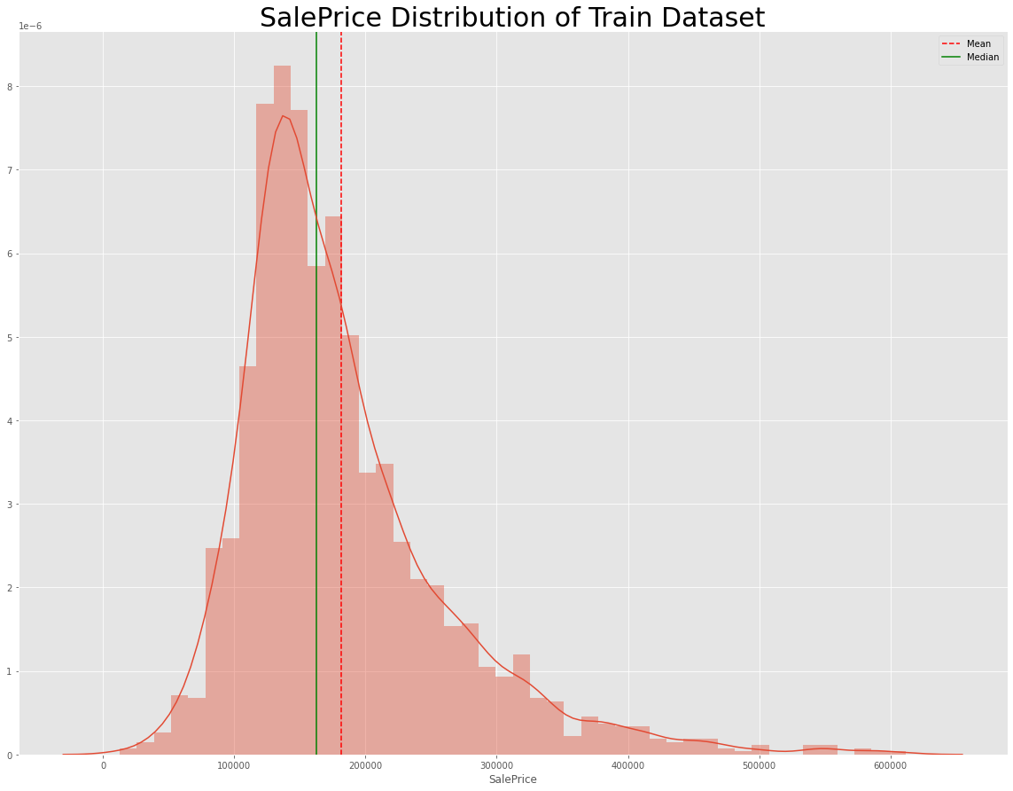
Exploration of Data
Continuous Data Plotting
Saleprice is positively skewed
the mean and median are more towards the lower prices
Notes:
Concentrated around the range of prices, there is much lesser houses with very high prices

Slide 10
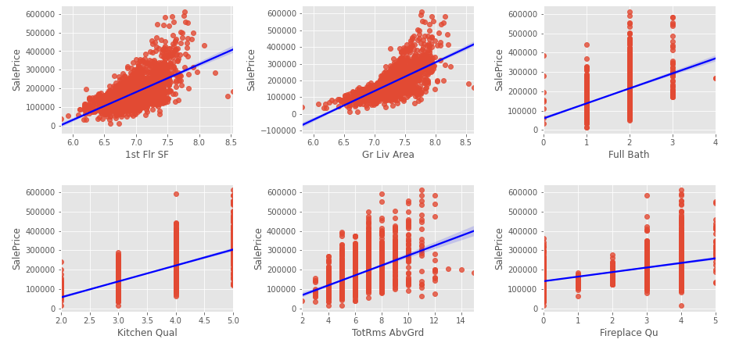
Exploration of Data
Continuous Data Plotting
Notes:
The curve of the data gets steeper when the prices gets higher

Slide 11
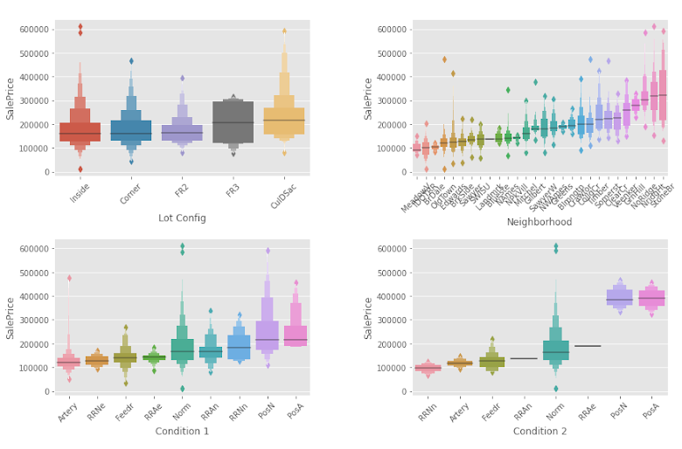
Exploration of Data
Discrete Data Plotting
Notes:
Using boxen plots instead of boxplots to also see the distributions of the data.

Slide 12
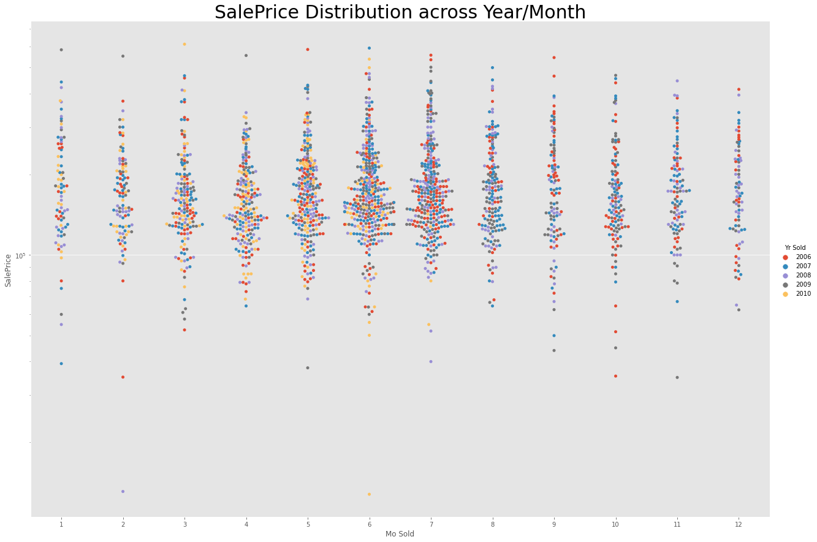
Exploration of Data
Time Series Swarmplot
June and July
Highest sales volume
Notes:
Lack of data of June 2010, could be due to a slowdown of sales or the collection of data is till june 2010
Number of sales increase in [June and July]!!!
This does not mean the saleprice is better during the month of June and july, but rather the sales of the houses will be easier as it is likely to be the house sales season

Slide 13
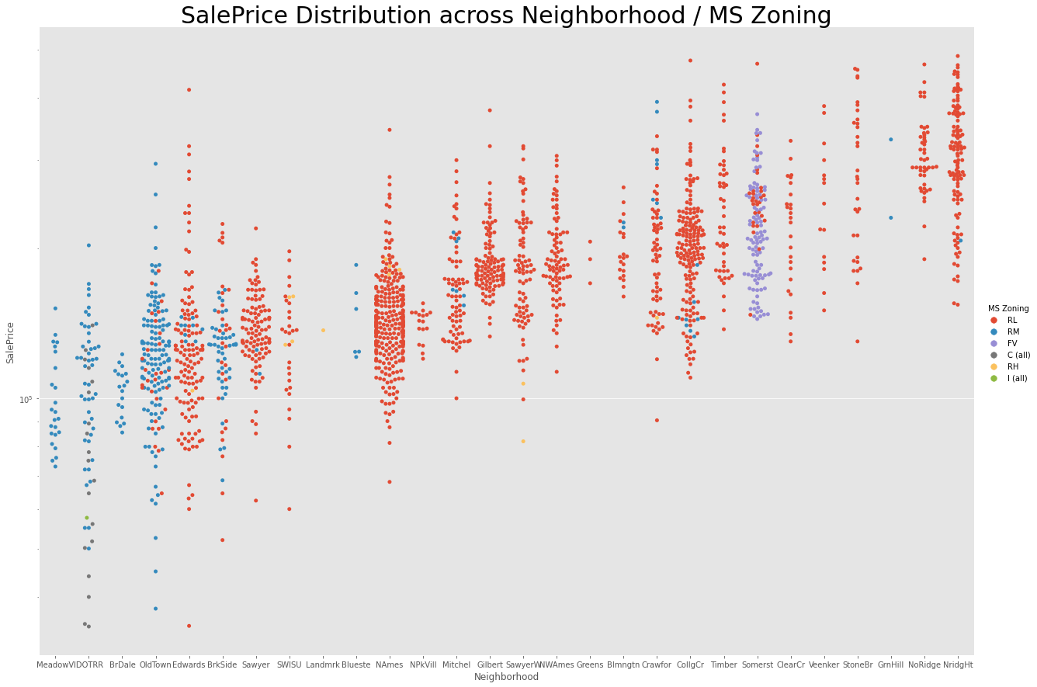
Exploration of Data
Neighbourhood Distribution Swarmplot
Neighbourhood factor is a key determinant of house prices
NOT IMPORTANT
in short-term house flipping investment
Legend: MS Zoning
A Agriculture
C Commercial
FV Floating Village Residential
I Industrial
RH Residential High Density
RL Residential Low Density
RP Residential Low Density Park
RM Residential Medium Density
Notes:
Neighborhood and MS Zoning for houseflipping will not affect profitability, as the range of saleprice in a specific location shld be around the same

Slide 14
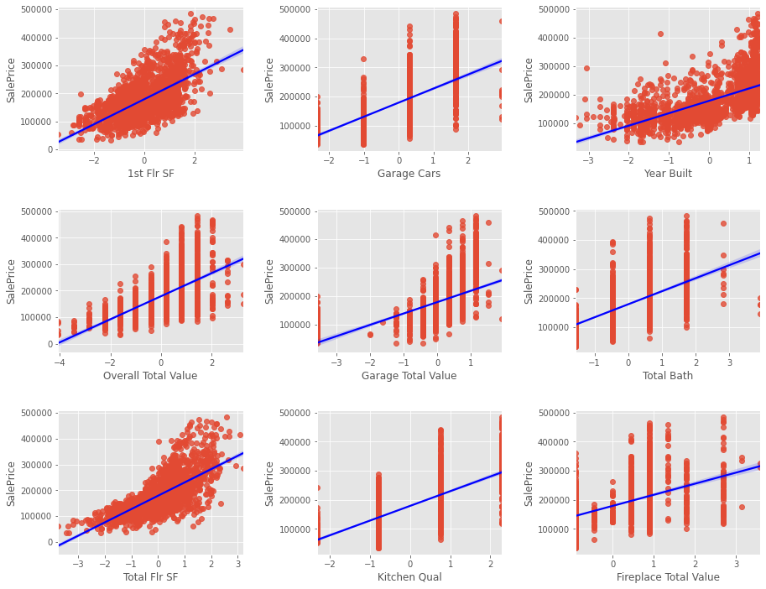
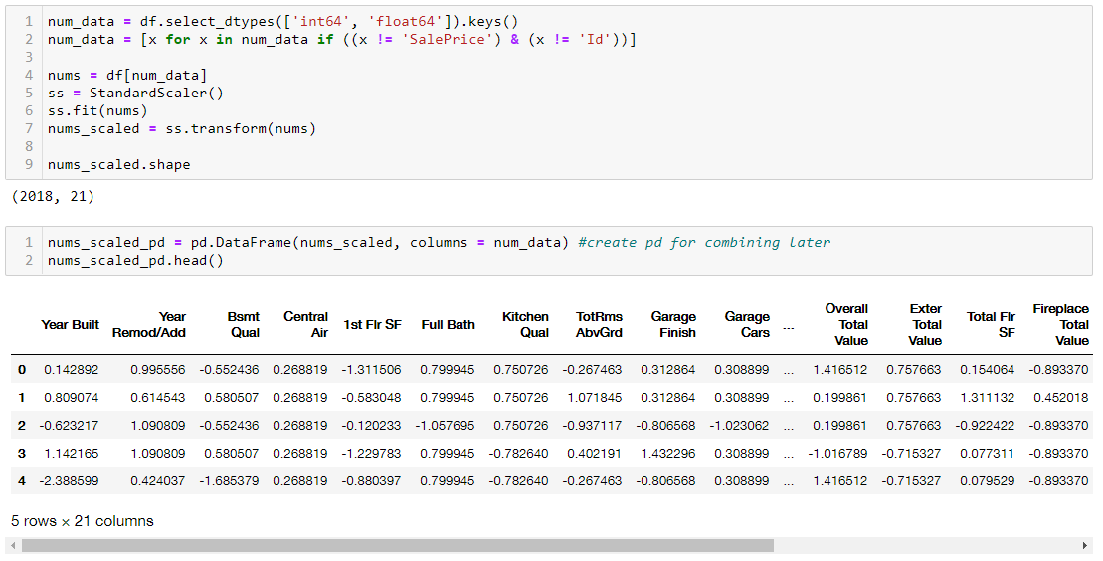
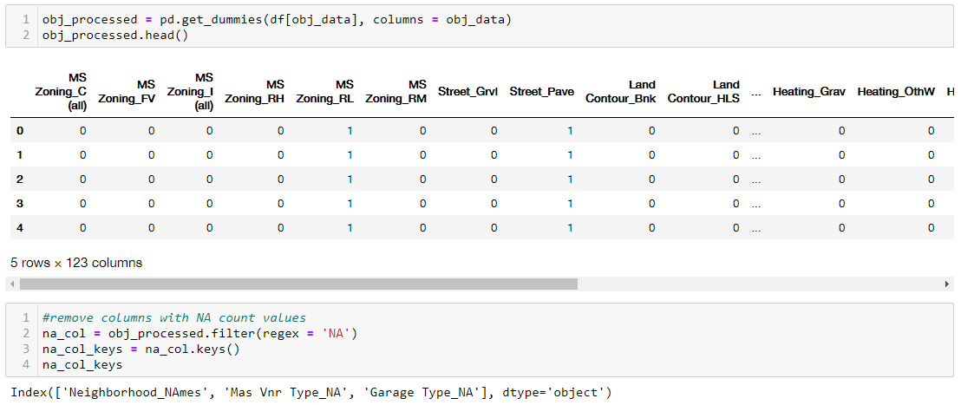
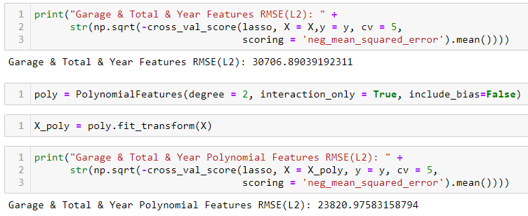
Feature Engineering
Standard Scaler, One_Hot Encoding, Polynomial Features
Standard Scaler
Scale the data to the same level across dataset
One Hot Encoding
Convert categorical data into numerical data
Polynomial Features/
Interaction Terms
Transform data to better fit the best fit line

Slide 15
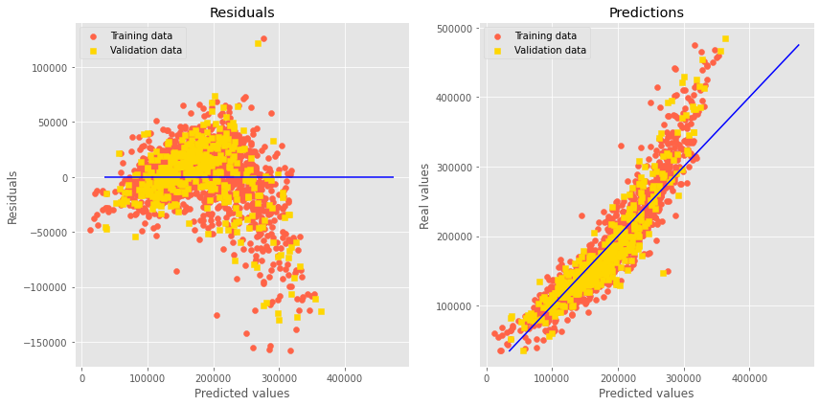
Model Baseline
Linear Regression
Model Baseline
Model tuning
Feature select
Final model
R2 Score
Train Score(Lr):
0.898
Validation Score(Lr):
0.870
Test Data Estimated score(Lr):
-8.607e+19
RMSE Scores
Train RMSE(Lr):
23224
Validation RMSE(Lr):
26995
Test Data Estimated RMSE(Lr):
53515

Slide 16
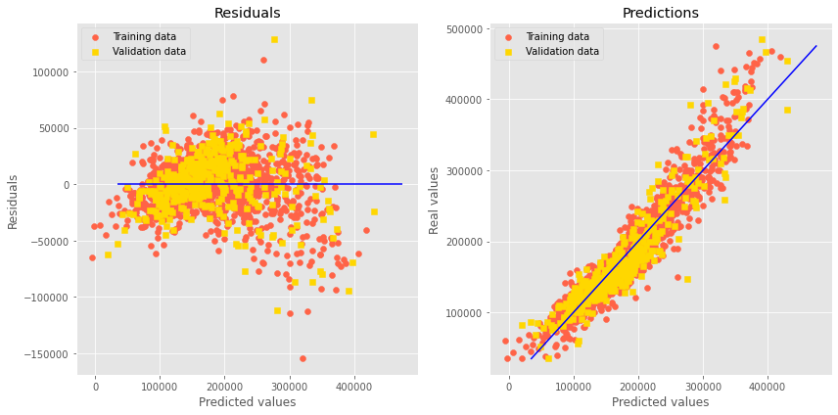
Model Tuning
Regularization
Model Baseline
Model tuning
Feature select
Final model
Using RidgeCV, LassoCV & ElasticNetCV (LassoCV chosen)
R2 Score
Train Score(Lr):
0.9029
Validation Score(Lr):
0.87680
Test Data Estimated score(Lr):
0.8771
RMSE Scores
Train RMSE(Lr):
22649
Validation RMSE(Lr):
26323
Test Data Estimated RMSE(Lr):
25480
Notes:
Regularization, finding optimum lambda

Slide 17
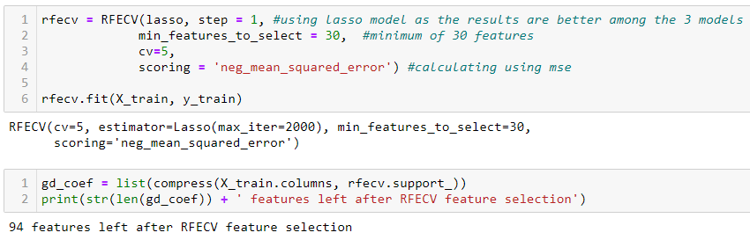
Feature Selection
RFECV
Model Baseline
Model tuning
Feature select
Final model
Using RFECV with the Lasso model to feature select the best coefficient features for further model tuning

Slide 18
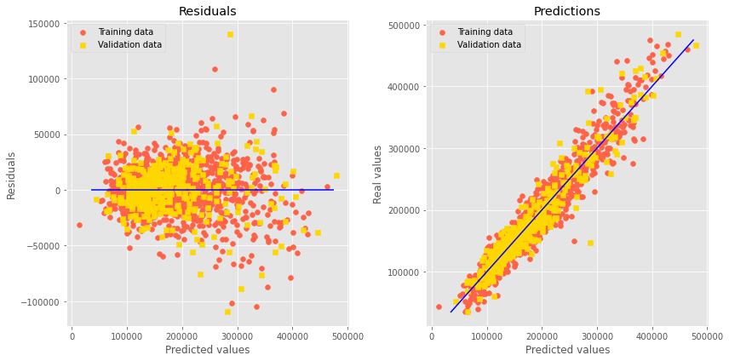
Final Model
Final Model (Lasso Regression)
Model Baseline
Model tuning
Feature select
Final model
R2 Score
Train Score(Lr):
0.9318 (bef: 0.898)
Validation Score(Lr):
0.9163 (bef: 0.0.870)
Test Data Estimated score(Lr):
0.9123 (bef: -8.607e+19)
RMSE Scores
Train RMSE(Lr):
18993 (bef: 23224)
Validation RMSE(Lr):
21692 (bef: 26995)
Test Data Estimated RMSE(Lr):
21504 (bef: 53515)
Notes:
Found the lambda to fit into full train data set

Slide 19
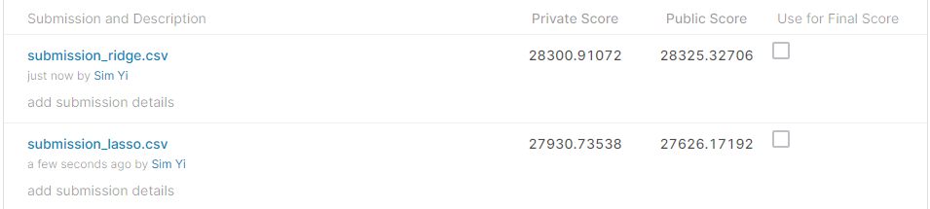
Kaggle Submission
Submission Model (Ridge and Lasso Regression)
Notes:
Scores doesnt seem to drop any further on kaggle after model tuning

Slide 20
Key challenges
What are some limitations we faced in our modelling exercise?
Data Collection
Lack of post-2010 data that are extremely vital to understanding trend of house prices due to 2008 Global Financial Crisis
Demographic & Economic data: How has the demographic and economic factors over the four years (and after) impacted housing market in Ames?
Lacking of certain data that could be helpful for our recommendations (e.g resale rate of property, key amenities around house, transportation services etc.)
Modelling
Many Features were highly correlated to each other, making it difficult to choose which features to use (multicollinearity issue)
Use of other more advanced modelling techniques (ie. RandomForest) could be more efficient in our prediction model.

Slide 21
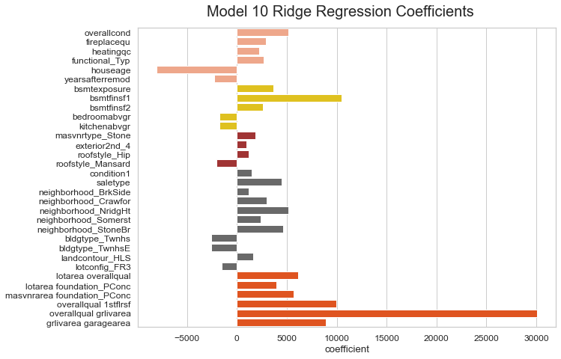
Results from our Model
What can we learn from our regression model?
Quality
Size
Renovation Materials
Others: Neighborhood, House type
Quality & Size
Notes:
Set a threshold for interaction terms, use hypothesis testing to cement the findings that quality and size

Slide 22
Recommendations
How to maximise returns from house flipping?
WHAT TO BUY?
Poor quality houses + Big area → Cheapest & Highest Potential
Houses with garage and basements → Lift house prices
HOW TO RENOVATE?
Poured Concrete Foundation
Hip-style roof
Metal Exterior Covering
Stone Masonry Veneer
WHEN TO SELL?
Summer (June-July)
Ensure that renovations lead to much higher quality
Big houses + Excellent quality leads to disproportionately higher sale price.

